Slide 1
User Issues and Queries when Operating TRICS
Nick Rabbets
Managing Director - TRICS Consortium Limited
Notes:
This presentation is really a targeted forum session, where I hope to get some ideas on the subject of User Issues and Queries when people are using the TRICS Database.
I have stretched this presentation out to two slides, this is the first one.

Slide 2
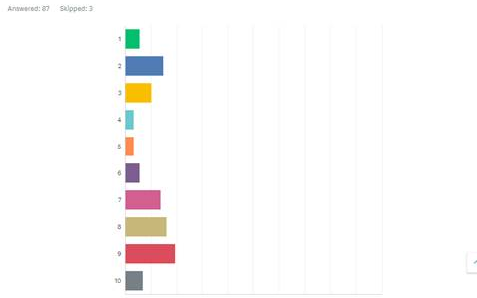
How “Problem free” do you find your interactions with TRICS (1=no problems, 10=many problems/issues)?
Notes:
So to my last slide
As you know we like to know what you think of our system and we listen to how you want it to progress and move forward, users have help develop the system over the past 29 years and we will continue to operate the same way in the future.
These are the results from one of the questions within the 2018 User Survey.
You can probably guess we would like to improve these figures and I hope we can now discuss the protentional reasons why the scores are the way they are.

Slide 3
How “Problem free” do you find your interactions with TRICS (1=no problems, 10=many problems/issues)?
Are these results due to confusion with the scoring method or wording of the question?
Are there improvements needed to any areas of the system?
User login Issues
Problem in Understanding the System
Continuity of Use – Error Messages being Displayed etc
Trip Rate Filtering Process
Lack of Data for certain Lan Use Sub-Categories
Problems with Understanding the Trip Rate Results
TRICS not doing what you want it to do
Wider Issues in Presenting the Data to Third Parties
Any Other Specific Issues
Notes:
Firstly – Are the results due to confusion with the scoring method or wording of the question? All the previous questions have a 10 as the best score, this question then askes for 10 being scored for the most problems. Perhaps this is why we have two peaks in the results. So should we reword the question to maintain continuity throughout the survey, so the score of 10 in this question means no problems.
Or do we also have some problems with the way TRICS works. I have listed a few areas that might spark some discussion within the room.

